Slide 1

E-commerce Sales Analysis project.
SIC – AI702
Notes:
1.7.2013
Note:
1
‹#›

Slide 2
Agenda
Team Members
Overview
Problem Statment
Data preparation
E.D.A
Analyzing e-commerce sales using Power BI
Samsung Innovation Campus

Slide 3




Team Members
Mohamed Elzagh
mariam sherif
Ahmed Hany
Samsung Innovation Campus

Slide 4
Overview
Samsung Innovation Campus
Notes:
1.7.2013
Note:
2
‹#›

Slide 5

Overview
This project focuses on conducting data analysis on E-commers data and finding key insights on the business using visualization tools and data manipulation tools to extract question to help the business in solving problems.
The ultimate goal is to transform raw data into an intuitive and interactive dashboard that empowers decision-makers.
Samsung Innovation Campus

Slide 6
Problem statement
Samsung Innovation Campus
Notes:
1.7.2013
Note:
2
‹#›

Slide 7
Problem statement
Which of our products are the true top-sellers?
Which geographical regions are driving the most revenue?
How do our sales fluctuate over time, and are there seasonal trends we can capitalize on?
Which month has the most profit?
Which customers has the most purchases?
What is the most used Payment Method?
What is the profit margin percentage?
Samsung Innovation Campus

Slide 8
Data preparation
Samsung Innovation Campus
Notes:
1.7.2013
Note:
2
‹#›

Slide 9
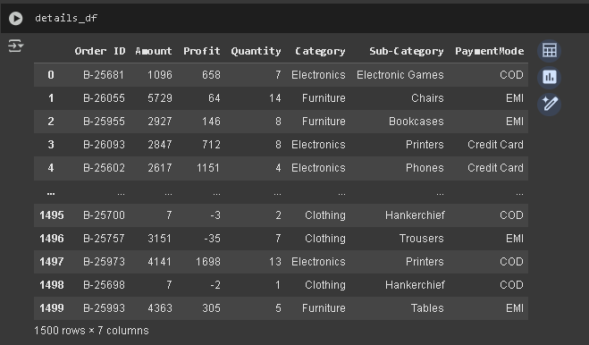
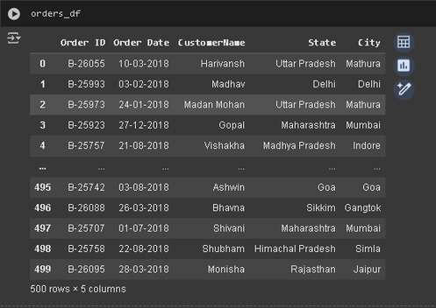
Data Overview
Two primary datasets were used for this analysis
Details.csv:
contains transactions info
Orders.csv:
contains order info
Samsung Innovation Campus

Slide 10
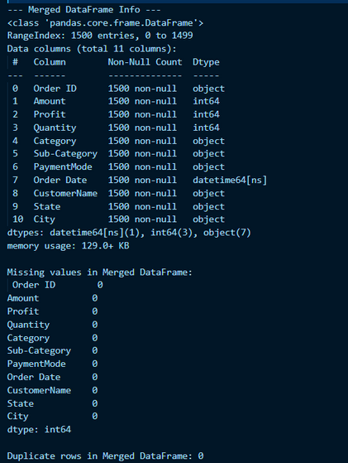
Data preprocessing
Checked the two csv’s
No missing data found
No dublicate records
Data format standrized
Merged Details.csv & Orders.csv into cleaned_online_sales_data.csv by the unique Order ID in both cvs’s
Samsung Innovation Campus
Notes:
1.7.2013
Note:
4
‹#›

Slide 11
E.D.A
Samsung Innovation Campus
Notes:
1.7.2013
Note:
2
‹#›

Slide 12
Statistical insights
₹291.85
₹24.64
Distribution Insights:
The data shows a right-skewed distribution for Amount and Profit, with a significant number of transactions generating negative profit. This suggests potential pricing or cost issues in certain product categories that need further investigation.
Average order amount
Average Profit
3.74
₹-1981 to ₹1864
Average Quantity
Profit Range
Key Insights:
High variability in profit
Significant number of transactions with negative profit
Median profit (₹8) much lower than mean profit (₹24.64), indicating skewed distribution
Quantity per order ranges from 1 to 14 items
Samsung Innovation Campus

Slide 13
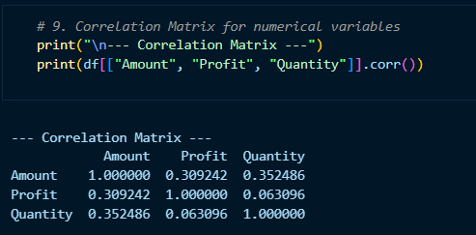
Correlation
We found 2 weak positive correlation and 1 with nearly no correlation between:
Amount / Profit: 0.309
Amount / Quantity: 0.352
profit / Quantity: 0.06
Samsung Innovation Campus

Slide 14
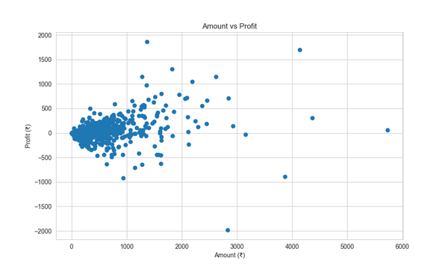
Amount Vs Profit
We found a correlation between Amount and Profit
Amount vs. Profit Correlation (r = 0.309)
Its a weak positive relationship; as the amount increase the profit slightly increase.
Why not stronger?
High sales often come with discounts or promotions
Cost differences across products reduce profit margins
expensive items are not always the most profitable
Key Insight:
Profit is driven more by margins and cost control than by sales amount alone
Samsung Innovation Campus

Slide 15
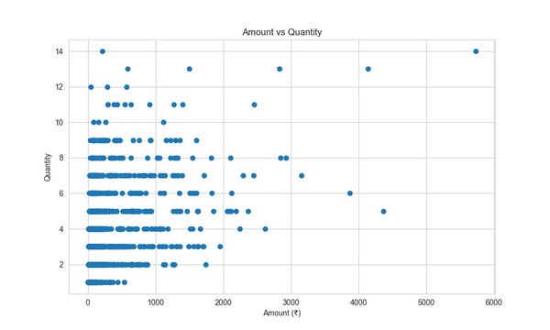
Amount Vs Quantity
We found a correlation between the Amount and Quantity
Orders Vs. Quantity Correlation (r = 0.352)
while Order sales value = item quantity × price, and adding items usually increases sales value, but not always linearly.
Why?
Wide range of low-cost vs. high-cost items
A single high-cost item can exceed the sales value of many low-cost items
Key insight:
Sales value is shaped not just by how many items are sold, but by which items are sold
Samsung Innovation Campus

Slide 16
Analyzing e-commerce sales using Power BI
Samsung Innovation Campus
Notes:
1.7.2013
Note:
2
‹#›

Slide 17

The importance of sales data analysis
Improve understanding of customer behavior and purchasing trends
Identify the most profitable and least performing products
Sales analysis by geographic region
Understanding payment method preferences and their impact on sales
Making data-driven business decisions
Samsung Innovation Campus

Slide 18
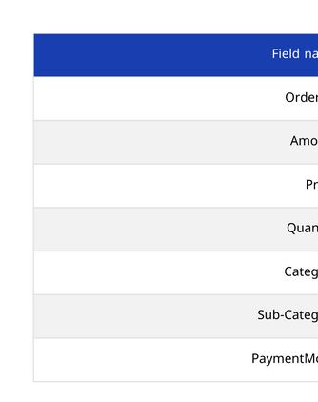
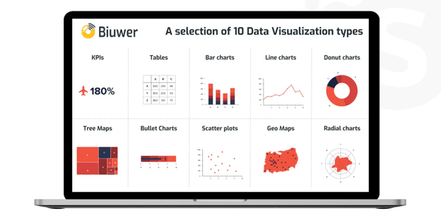

Sales data structure
Key Insights
Organizing data in this way allows analysis of the relationship between product categories, payment methods, and profitability, helping to determine which products have the highest profit margins and which payment methods are most popular with customers.
Samsung Innovation Campus

Slide 19


Order Dashboard
Key points
Monthly Trends: The dashboard shows profit and amount trends by month, helping to identify seasonal patterns.
Best-selling products: Displays the best-selling subcategories, helping to improve inventory strategies.
Sales breakdown by category: Analysis of sales ratios between major categories (clothing, electronics, furniture).
Monthly Details: A table showing the quantity and amount details by category for each month
Insights gained
The data shows that the profit margin (8.44%) is relatively low, indicating a need to review pricing strategies. There is also significant variation in profitability across categories, with electronics achieving higher profit margins than clothing and furniture
Samsung Innovation Campus

Slide 20
Customer Dashboard
Customer Behavior Summary
The analyzed client made a total of $437,771, with a profit of $36,907, and the preferred payment method was cash on delivery (COD).
Key points
Customer Contribution: Analyze each customer's contribution to total sales.
Monthly Profit Trends: Track your most profitable periods.
Payment Methods: Analyze sales distribution by payment method.
Insights gained
Customers' preference for cash on delivery (COD) and credit cards underscores the importance of providing diverse payment options. Fluctuating monthly profits also call for developing seasonal marketing strategies to improve sales during less active periods
Samsung Innovation Campus
Notes:
1.7.2013
Note:
2
‹#›

Slide 21
Online Sales Dashboard
Main features
Multiple filters: filter by category, subcategory, and state.
Geographic Analysis: Sales Distribution Map by State.
Key points
Customer Contribution: Analyze each customer's contribution to total sales.
Monthly Profit Trends: Track your most profitable periods.
Payment Methods: Analyze sales distribution by payment method.
Insights gained
Data shows that the furniture category represents the largest portion of sales (55%), indicating the importance of focusing on this category in marketing strategies. Geographic analysis also shows that sales are concentrated in specific regions, presenting an opportunity for expansion into less active areas.
Samsung Innovation Campus
Notes:
1.7.2013
Note:
2
‹#›

Slide 22
Conclusion and recommendations
Main results
The furniture category represents the largest percentage of sales, followed by electronics and then clothing.
Cash on Delivery (COD) is the preferred method for customers.
There is a variation in profitability between different categories, with electronics generating a higher profit margin.
Recommendations
Improve inventory strategy
Focus on higher-margin products and improve inventory management for less profitable products.
Developing marketing strategies
Target top-performing geographies and tailor marketing campaigns to lower-selling categories.
Diversify payment methods
Encourage the use of electronic payment methods by offering discounts or additional benefits.
Samsung Innovation Campus
Notes:
1.7.2013
Note:
2
‹#›

Slide 23

ⓒ2020 SAMSUNG. All rights reserved.
Samsung Electronics Corporate Citizenship Office holds the copyright of book.
This book is a literary property protected by copyright law so reprint and reproduction without permission are prohibited.
To use this book other than the curriculum of Samsung innovation Campus or to use the entire or part of this book, you must receive written consent from copyright holder.
Notes:
1.7.2013
14
‹#›

